Slide 1
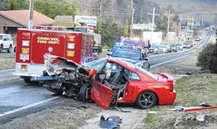
Predicting Severity of a Car Accident
KUBER BISHT
14-Oct-2020

Slide 2
INTRODUCTION
According to World Health Organization (WHO), approximately 1.35 million people die each year in road accidents. The number of road accident casualties and damage is much higher in developing countries than in developed countries. Many factors (driver, environment, vehicle, etc.) are related to traffic accidents, some of those factors are more important in determining the accident severity than others. Road traffic injuries cause considerable economic losses to individuals, their families, and to nations. If the severity of a car accident can be predicted based on historical data. It will result in less severe or no accidents, safer roads and transportation. Machine learning techniques can be used on a given data to build a model to predict the severity of accidents in advance.

Slide 3
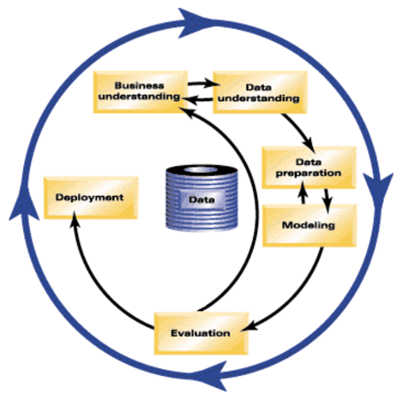
METHODOLOGY USED
CRISP-DM methodology will be used for building this model. It is comprised of six steps with an entity that has to implement in order to have a reasonable chance of success.

Slide 4
METHODOLOGY USED
Business Understanding
Data Understanding
Data Preparation
Data Classification/Modeling
Model Evaluation
Deployment/Results

Slide 5
Business Understanding
As per the given project, a machine learning model is to be developed for predicting severity of a car accident in advance to avoid accident. There are approximately 1.35 million people die each year during accidents. If there are capability to predict the severity of an accident, it can save many lives, makes road and transportation safe.

Slide 6
Data Understanding
I’ve used the shared Seattle city data for accidents from 2004 to 2020 as an example.
A metadata was available, defining each data element of the shared data.

Slide 7
Data Preparation
The given dataset had 37 columns and 194673 rows having information about different accidents occurred from Year 2004 through 2020.
Not all columns were needed to build model as these were not related to the reason for accident.
After finalizing the columns to be used for building model, some rows were deleted depending upon the missing values in the given columns to clean the data.
Few columns were updated for the missing information for data consistency.
More information was extracted to be used for modeling from existing data. For example datetime value used to get Year, Month, Day, HourOfDay, Weekday etc.
Few Column names were renamed to give them meaningful name.
After data preprocessing there are 17 columns and 180067 rows.

Slide 8
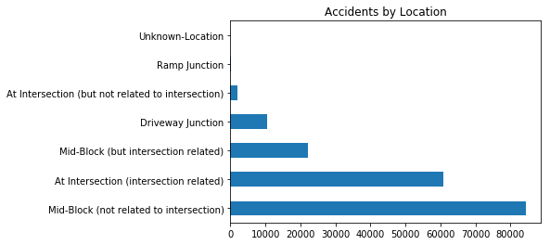
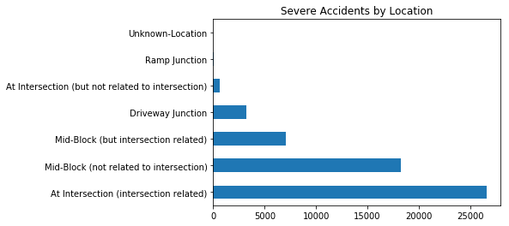
Modeling-Data Analysis
As per accident location, most of the accident took place at mid block not related to intersection. But, most of severe accidents took place at intersection and were related to intersection.

Slide 9
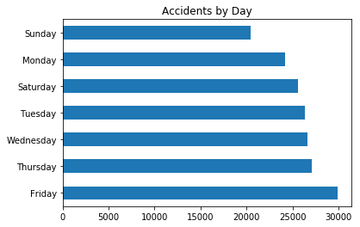
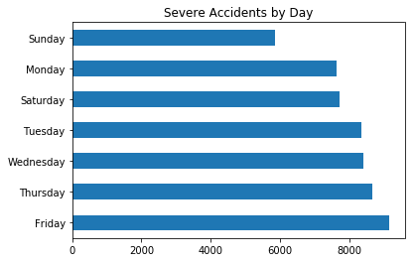
Modeling-Data Analysis
As per accident by day, most of the accident took place on Friday.

Slide 10
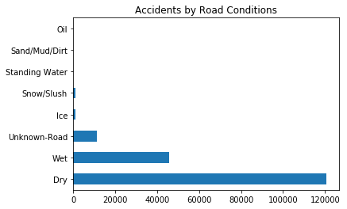
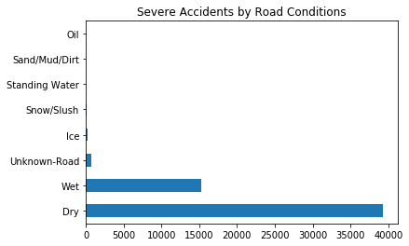
Modeling-Data Analysis
As per accident by road conditions, most of the accident took place on dry roads.

Slide 11
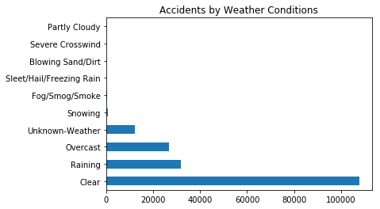
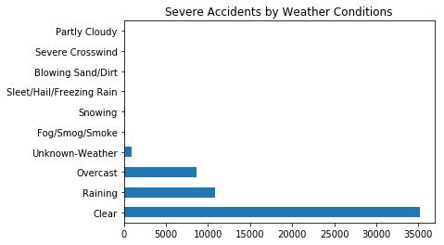
Modeling-Data Analysis
As per accident by weather conditions, most of the accident took place on clear days or while it was raining or overcast.

Slide 12
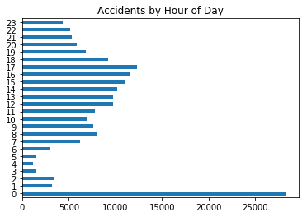
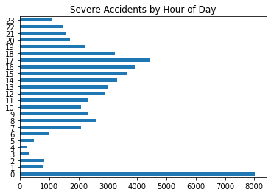
Modeling-Data Analysis
As per accident by hour of the day, most of the accident took place at mid-night or between hour 12 to hour 17.

Slide 13
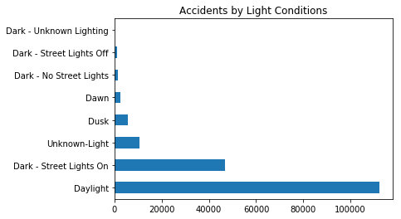
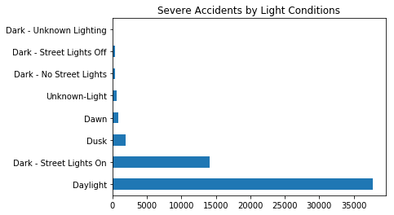
Modeling-Data Analysis
As per accident by light conditions, most of the accident took place in day light.

Slide 14
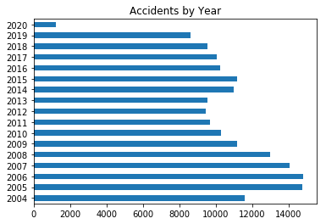
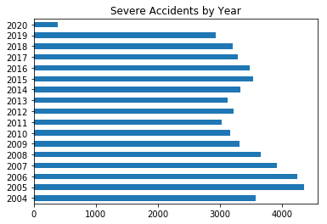
Modeling-Data Analysis
As per accident by year, from 2005, number of accidents decreased each year to year 2012. But, it started rising from year 2012 to year 2015. And again after year 2015, there is decrease in number of accidents every year.

Slide 15
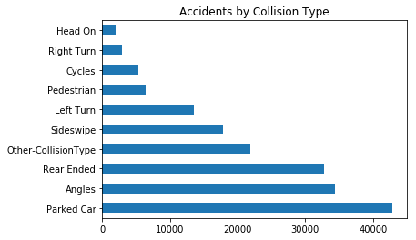
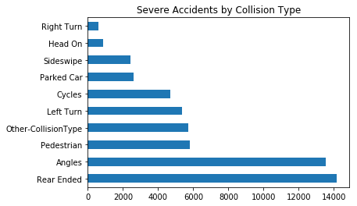
Modeling-Data Analysis
As per accident by collision type, most of the accidents were with parked cars. But, most of severe accidents were rear ended.

Slide 16
Modeling-Feature Selection
Most of the criterion used for analyzing the data were converted to different columns for building the supervised machine learning model.
After converting the features to columns, respective columns were removed from the data.
After feature selection there were 140 column and 180067 rows of data.

Slide 17
Data Classification / Modeling
Different classification techniques were used for modeling the given data. We used in the ratio of 80:20 for training and testing, for getting the results. The various techniques that I used were
Random Forest
K Nearest Neighbor (KNN)
Decision Tree
Logistic Regression
XGBoost

Slide 18
Model Evaluation / Results
S. No. | Classification Technique | Training Accuracy | Testing Accuracy
1 | Random Forest | 99.99% | 73.73%
2 | K Nearest Neighbors (KNN) (k=10) | 74.49% | 71.37%
3 | Decision Tree at max_depth = 10 | 74.39% | 74.06%
4 | Logistic Regression (solver='liblinear’) | 74.19% | 74.16%
5 | XGBoost | 76.81% | 73.98%

Slide 19
Results-Discussion
After using various modeling techniques, the logistic regression provided best results. The training set accuracy was highest for Random forest but test set accuracy for almost all models was approximately 73% to 74%. This might be due to unbalance in the given data as the number of severe accidents were very less in number as compared to other accidents. Also, the dataset was small and it might not had much data for severe accidents, that has resulted in lower accuracy as all features might not be available for predicting the severe accidents to predict severity with greater accuracy. We can use the same methodology on a larger dataset to get good results.

Slide 20
Conclusion
After analyzing and modeling the data, we can say most of the severe accidents happened on dry roads, clear weather and near intersection and were related to the intersection. A lot of severe accidents can be avoided if more precautions are used near intersection. For predicting severity of accidents with greater accuracy a large dataset is needed and it should be updated periodically and accurately. Model should also be updated with new data to increase the accuracy of predicting the severity of an accident.

Slide 21
Thanks

